Slide 1


Lecture 1 Introduction to Functional Programming & Scala
14.3.2023
Dr. Iflaah Salman

Slide 2
Functional Programming
Imperative Programming
Perceived as traditional programming
C, C++, JAVA, C#
The programmer tells the computer what to do, e.g., x = y + z.
Oriented around control statements, looping constructs and assignments.
Functional Programming
Aims on describing the solution
What the program needs to be doing (rather than how it should be done).

Slide 3
Functional Programming
It is based on pure functions.
Functions that have no side effects!
Side Effects: rather than simply returning the results, a function does one of the following:
Modifying a variable
Modifying a data structure in place
Setting a field on an object
Throwing an exception or halting with an error
Printing to the console or reading user input
Reading from or writing to a file
Drawing on the screen

Slide 4
Functional Programming
“FP is a restriction on how we write programs, but
not on what programs can express”.
It increases modularity via programming pure functions that are easier to:
test
reuse
parallelize
generalize
can be reasoned
Pure functions are less prone to bugs!

Slide 5
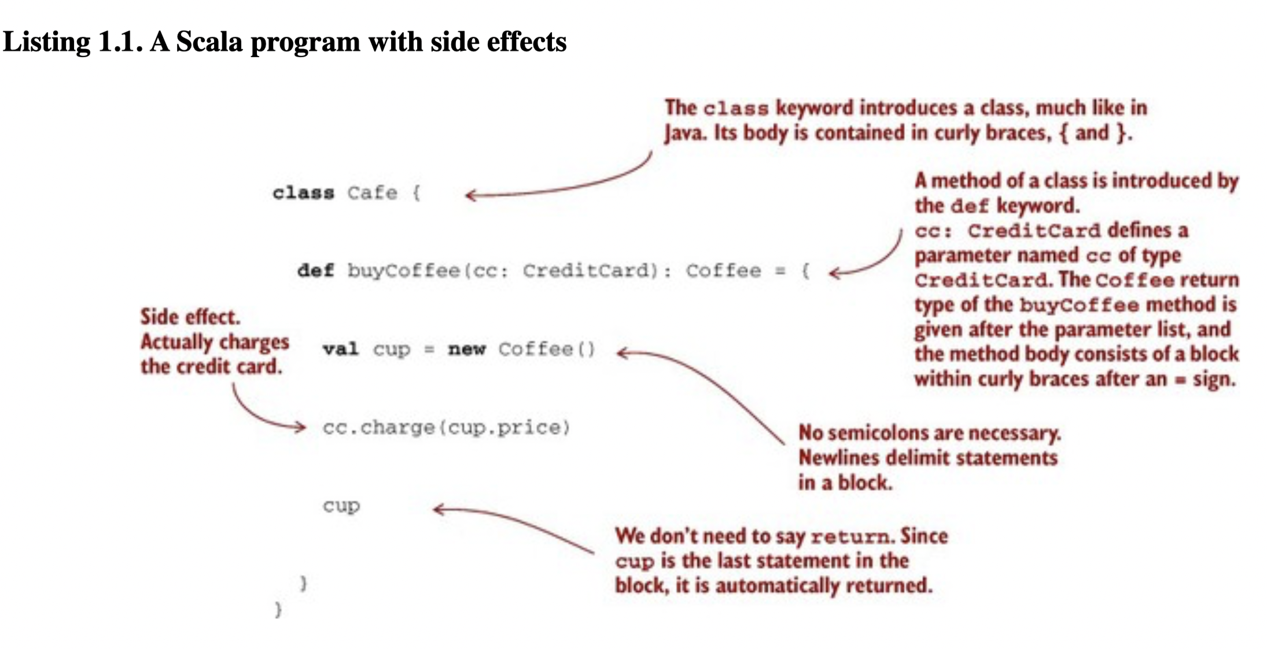
A Program with Side Effects
our function merely returns a Coffee and these other actions are happening on the side.
Difficult to test because it is contacting the credit card company, and we don’t want our tests to do that.
Notes:
The statement cc.charge(cup.price) is an example of a side effect.
Charging a credit card involves some interaction with the outside world—suppose it requires contacting the credit card company via some web service, authorizing the transaction, charging the card, and (if successful) persisting some record of the transaction for later reference. But our function merely returns a Coffee and these other actions are happening on the side, hence the term “side effect.”

Slide 6
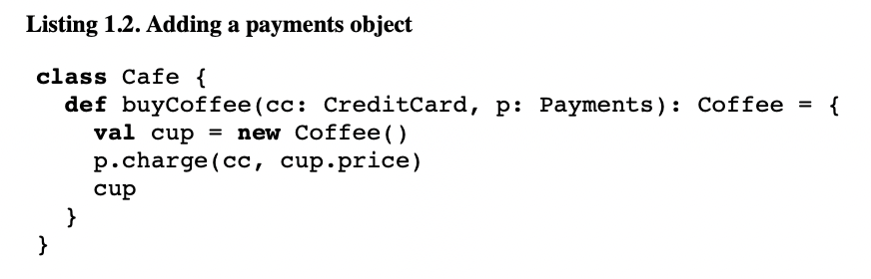
A Program with Side Effects making it more testable
We have gained some level of testability.
We can develop mocks to test Payments (which can be an interface).
Notes:
We can make the code more modular and testable by letting Credit-Card be ignorant of these extra concerns and passing a Payments object into buyCoffee.
Though side effects still occur when we call p.charge(cc, cup.price), we have at least regained some testability.
Payments can be an interface, and we can write a mock implementation of this interface that is suitable for testing.
But that isn’t ideal either. We’re forced to make Payments an interface, when a concrete class may have been fine otherwise, and any mock implementation will be awkward to use. For example, it might contain some internal state that we’ll have to inspect after the call to buy-Coffee, and our test will have to make sure this state has been appropriately modified (mutated) by the call to charge. We can use a mock framework or similar to handle this detail for us, but this all feels like overkill if we just want to test that buyCoffee creates a charge equal to the price of a cup of coffee.
Mutilple coffee buying scenario We could write a whole new function, buyCoffees, with special logic for batching up the charges.^{[1]} Here, that might not be such a big deal, since the logic of buyCoffee is so simple, but in other cases the logic we need to duplicate may be nontrivial

Slide 7
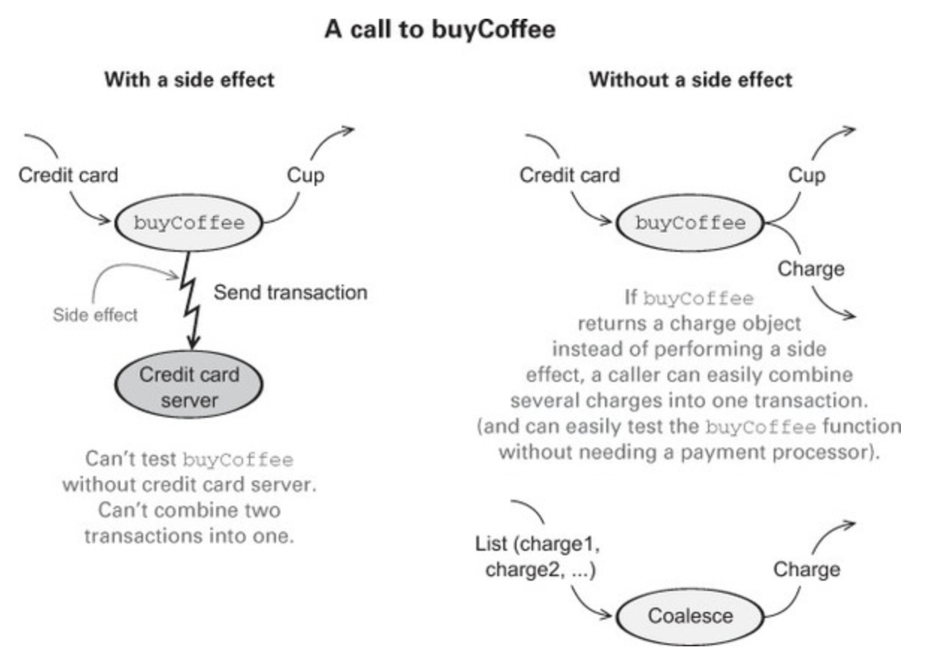
A Program with Side Effects reusability
The code was still difficult to reuse.
Scenario: In the case of buying more than one coffee, calling the function that many times (in a loop) would contact the bank that many times and that many processing charges.
Notes:
We could write a whole new function, buyCoffees, with special logic for batching up the charges.^{[1]} Here, that might not be such a big deal, since the logic of buyCoffee is so simple, but in other cases the logic we need to duplicate may be nontrivial.
A specialized BatchingPayments implementation of the Payments interface, that batches successive charges to the same credit card. This gets complicated though. But how big the batch has to be? When to stop? Ans: Additional logic for closing the batch. But, still, when it’s appropriate to do?

Slide 8
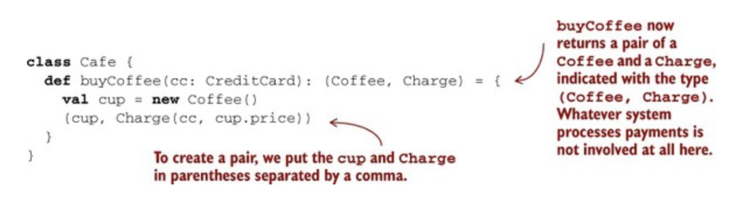
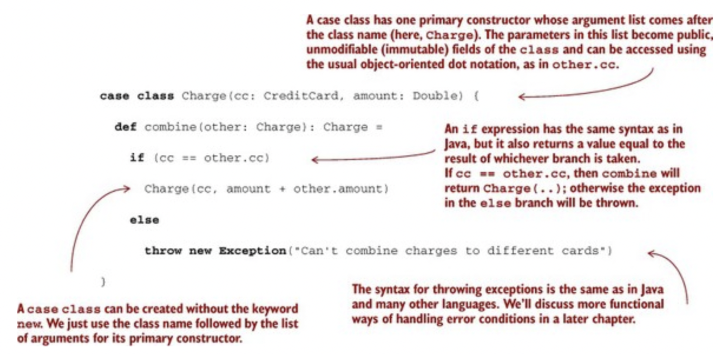
A Program with Side Effects removing side effects
case class Charge(cc: CreditCard, amount: Double) { def combine(other: Charge): Charge =
if (cc == other.cc)
Charge(cc, amount + other.amount)
else
throw new Exception("Can't combine charges to different cards")
}
Notes:
The functional solution is to eliminate side effects and have buyCoffee return the charge as a value in addition to returning the Coffee. The rest of the concerns will be handled else where.
Charge is a data type we just invented containing a CreditCard and an amount, equipped with a handy function, combine, for combining charges with the same CreditCard

Slide 9
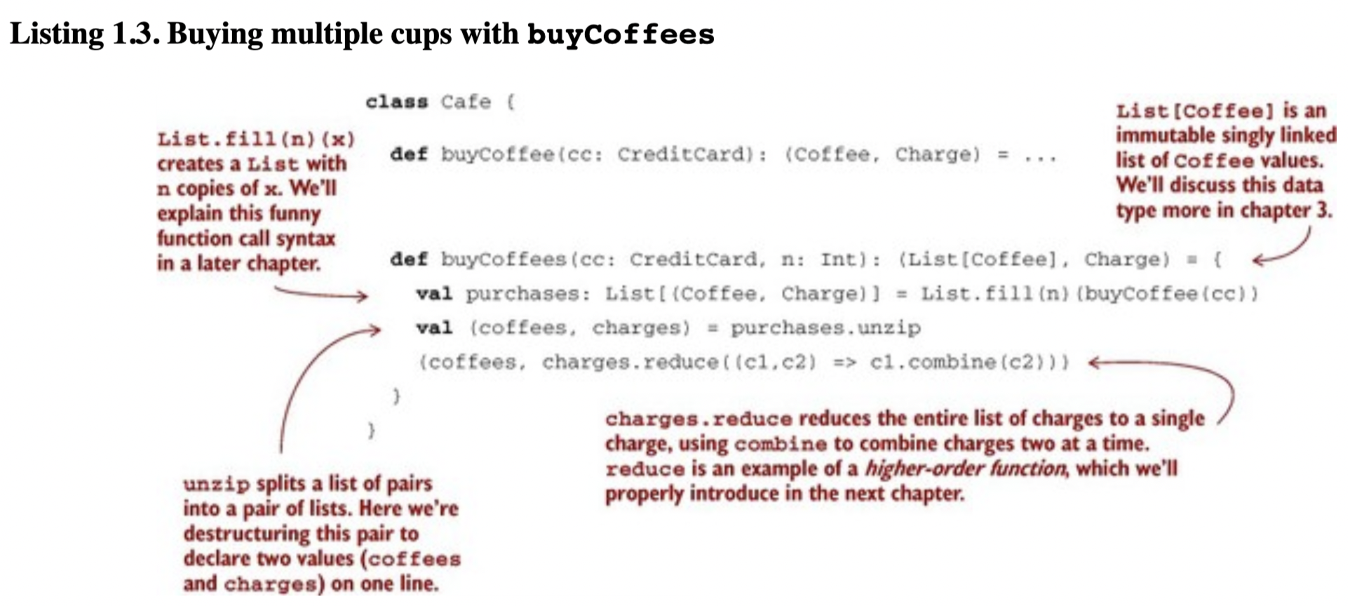
A Program with Side Effects
Notes:
Look how are we changing the buyCoffee() to buy multiple cups of coffee.
We’re now able to reuse buyCoffee directly to define the buyCoffees function, and both functions are trivially testable without having to define complicated mock implementations. We can still have a Payments class for actually processing charges, of course, but Café doesn’t need to know about it.
Making Charge into a first-class value has other benefits: we can more easily assemble business logic for working with these charges. For example: to handle the case of occasional purchases, but with a one-time payment.
This is just a taste of why functional programming has the benefits claimed, and this example is intentionally simple. If the series of refactorings used here seems natural, obvious, unremarkable, or standard practice, that’s good.

Slide 10
Functional Programming
“FP is merely a discipline that takes what many consider a good idea to its logical endpoint, applying the discipline even in situations where its applicability is less obvious.”

Slide 11
A Pure Function is easier to reason about
A function f with input type A and output type B
(written in Scala: A => B, pronounced “A to B” or “A arrow B”)
is a computation that relates every value a of type A to exactly one value b of type B such that b is determined solely by the value of a.
Any changing state of an internal or external process is irrelevant to computing the result f(a).
Example:
function: intToString
Int => String
“IF it really is a function, it will do nothing else!”
function: length function of a String in Java, Scala
Returns only length; the same length is always returned.
strings are not modified (immutability)
Notes:
A function has no observable effect on the execution of the program other than to compute a result given its inputs; we say that it has no side effects.
2. strings can’t be modified (are immutable). For any given string, the same length is always returned and nothing else occurs.

Slide 12
Referential Transparency pure functions
Referential transparency (RT) is a property of expressions and not just functions.
2 + 3 = 5
2, 3 are expressions; + is the pure function. This has no side effects.
The answer is always 5 OR always evaluates to 5.
If in a program we replace 2 + 3 with 5, no behaviour or meaning will change.
“A function is pure if calling it with RT arguments is also RT.”
“An expression e is referentially transparent if, for all programs p, all occurrences of e in p can be replaced by the result of evaluating e without affecting the meaning of p. A function f is pure if the expression f(x) is referentially transparent for all referentially transparent x.”
Notes:
This is all it means for an expression to be referentially transparent—in any program, the expression can be replaced by its result without changing the meaning of the program.

Slide 13
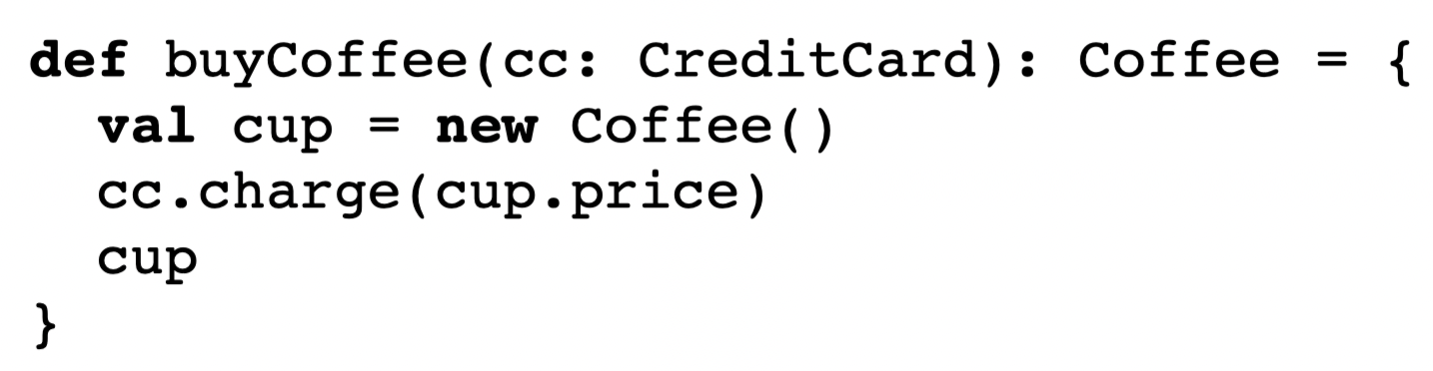
Referential Transparency purity and substitution model
buyCoffee(customerCreditCard) will evaluate to cup
cup is new Coffee()
NOW
p(buyCoffee(customerCreditCard)) != p(new Coffee())
Therefore, it does not held RT and purity.
RT forces the invariance that everything a function does is represented by the value that it returns, according to the result type of the function.

Slide 14
Referential Transparency purity and substitution model
RT enables a simple and natural mode of reasoning about program evaluation called the substitution model.
Computation proceeds like an algebraic equation.
RT enables equational reasoning about programs.
In an algebraic equation, every part of an expression is expanded, replacing all variables with their referents, and then, reducing it to its simplest form. At each step, a term is replaced with an equivalent one; computation proceeds by substituting equals for equals.

Slide 15
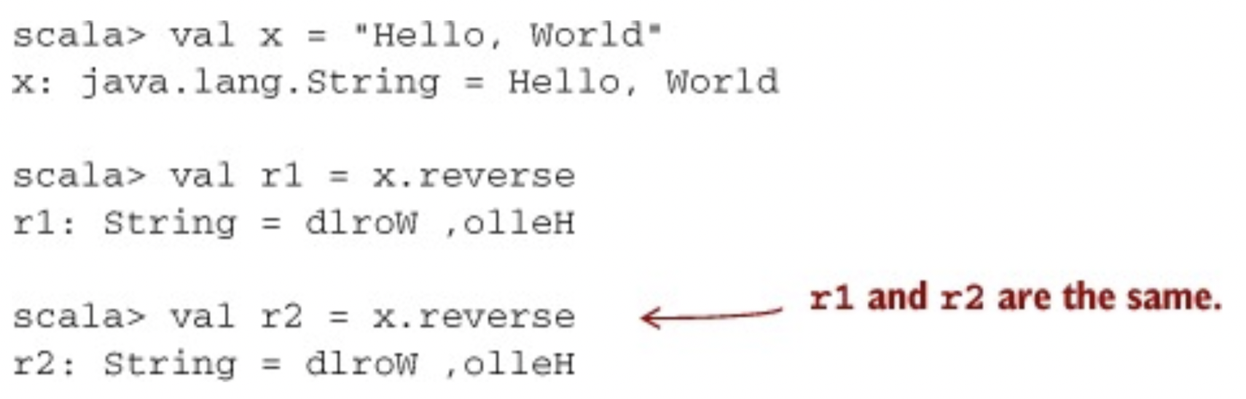
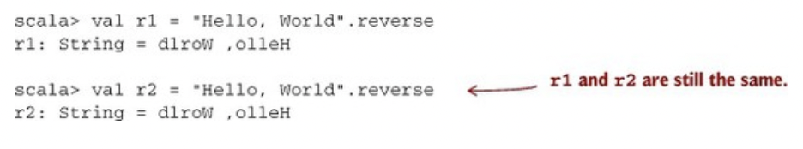
Referential Transparency purity and substitution model
replace all occurrences of x with the expression referenced by x.
Replacement/expansion didn’t affect the result.
Therefore, x was referentially transparent.
Notes:
In java ad scala strings are immutable.
A “modified” string is really a new string and the old string remains intact.

Slide 16
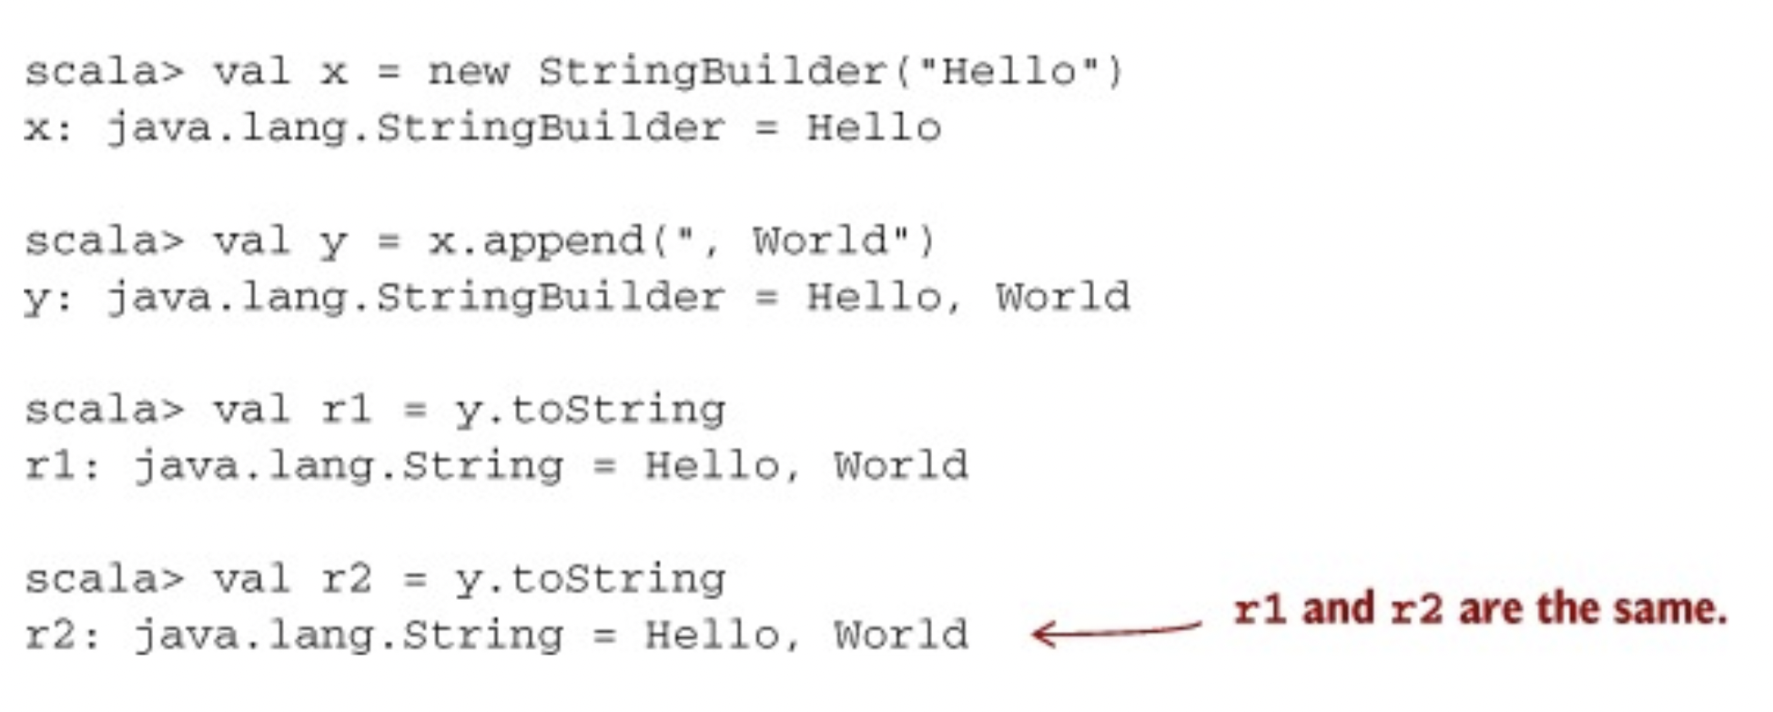
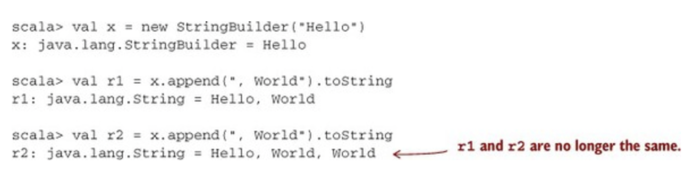
Referential Transparency not RT example
now we substitute the call to append(), replacing all occurrences of y with the expression referenced by y
By the time r2 calls x.append(),
r1 had already mutated the object referenced by x.
Notes:
This function operates on the StringBuilder in place. The previous state of the StringBuilder is destroyed after a call to append.
We, therefore, conclude that StringBuilder.append is not a pure function. What’s going on here is that although r1 and r2 look like they’re the same expression, they are in fact referencing two different values of the same StringBuilder. By the time r2 calls x.append, r1 will have already mutated the object referenced by x. If this seems difficult to think about, that’s because it is. Side effects make reasoning about program behavior more difficult.

Slide 17
The function is not referentially transparent. The value returned depends on x which may be changed by another process. If you think of this in terms of Object Oriented programming, x could be a class member variable and plus a class method. Such operations are referentially opaque and are common in the OO paradigm.

Slide 18

Mentimeter
Go to mentimeter
The voting code
4637 4742

Slide 19

Scala

Slide 20
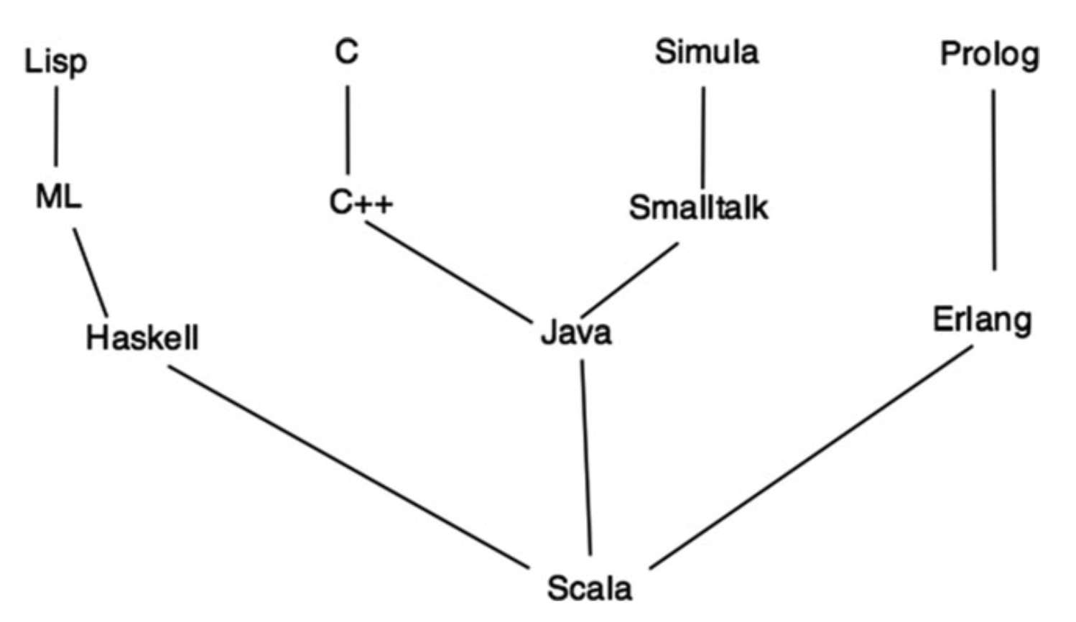
Scala

Slide 21
Scala
It is a multi-paradigm (a hybrid) language: OOP + FP.
From the OOP perspective, it is quite like JAVA or C++.
It also enables functional programming like Haskell.
It can be compiled into a JAVA byte code – runs on JVM.
It has interoperability with JAVA.
JRE allows Scala to exploit its libraries.
Notes:
Scala is a new programming language developed by Martin Odersky and his teamat the EPFL (Ecole Polythenique Fererale de Lausanne, Lausanne, Switzerland) andnow supported by Lightbend Inc. (previously known as Typesafe).

Slide 22

References
Chiusano, P., & Bjarnason, R. (2014). Functional Programming in Scala. Manning publications.
Hunt, J. (2018). A Beginner’s Guide to Scala, Object Orientation and Functional Programming. In A Beginner’s Guide to Scala, Object Orientation and Functional Programming. Springer International Publishing. https://doi.org/10.1007/978-3-319-75771-1

